Slide 1
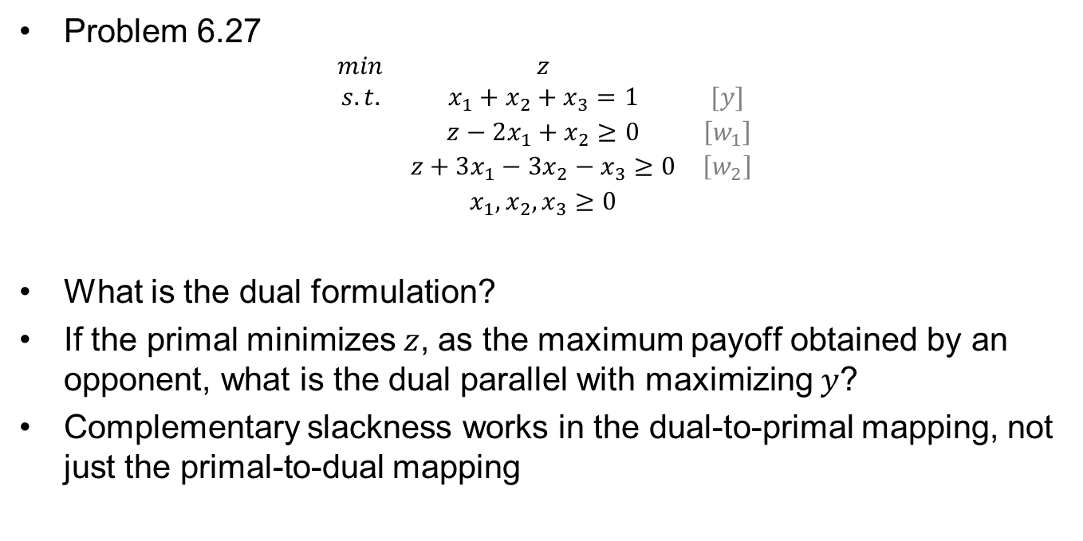
Homework #11 Feedback
Problem 6.27
$$\begin{matrix}min & z & \\ s.t. & x_{1}+x_{2}+x_{3}=1 & [y] \\ & z−2x_{1}+x_{2}≥0 & \left[w_{1}\right] \\ & z+3x_{1}−3x_{2}−x_{3}≥0 & \left[w_{2}\right] \\ & x_{1},x_{2},x_{3}≥0 & \end{matrix}$$
What is the dual formulation?
If the primal minimizes $z$, as the maximum payoff obtained by an opponent, what is the dual parallel with maximizing $y$?
Complementary slackness works in the dual-to-primal mapping, not just the primal-to-dual mapping

Slide 2





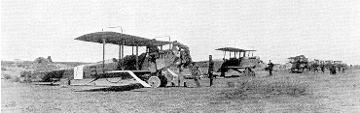






What are these called? Which is not a US one?

Slide 3
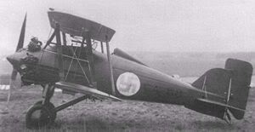
What country flew this aircraft?

Slide 4

OPER 610 Lesson 16 Interior Point Methods 1B: Karmarkar’s Projective Algorithm
1957 –
Dr Brian J. Lunday
Office: Rm 201E, Bldg 641

Slide 5
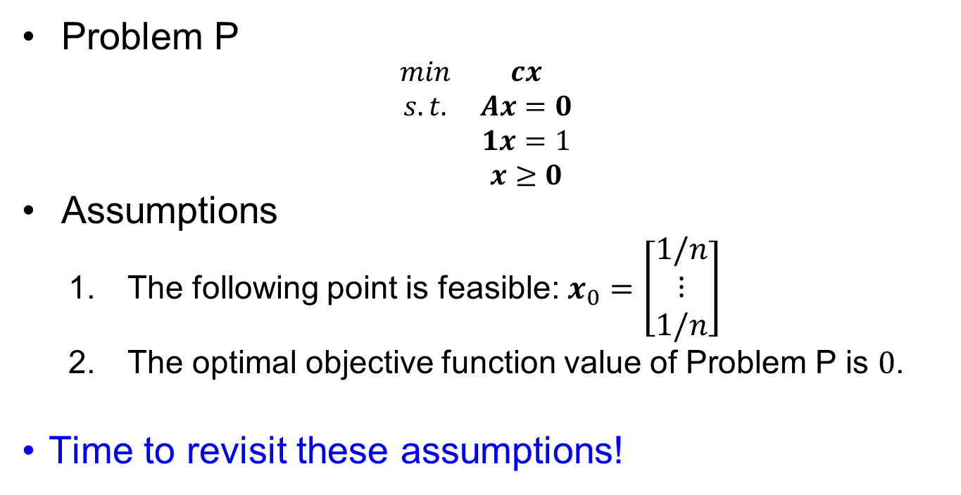
Basic Problem & Assumptions
Problem P
$$\begin{matrix}min & cx \\ s.t. & Ax=0 \\ & 1x=1 \\ & x≥0\end{matrix}$$
Assumptions
The following point is feasible: $x_{0}=\left[\begin{aligned}1/n \\ ⋮ \\ 1/n\end{aligned}\right]$
The optimal objective function value of Problem P is $0$.
Time to revisit these assumptions!

Slide 6
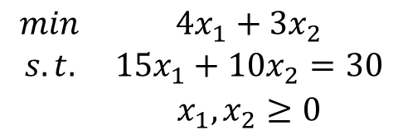
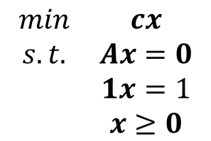
The Original Problem
$$\begin{matrix}min & cx \\ s.t. & Ax=0 \\ & 1x=1 \\ & x≥0\end{matrix}$$
$$\begin{matrix}min & 4x_{1}+3x_{2} \\ s.t. & 15x_{1}+10x_{2}=30 \\ & x_{1},x_{2}≥0\end{matrix}$$
Order of transformations
Satisfy Assumption #2
Put it into Standard Form (for this algorithm)
Satisfy Assumption #1

Slide 7
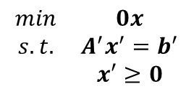
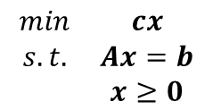
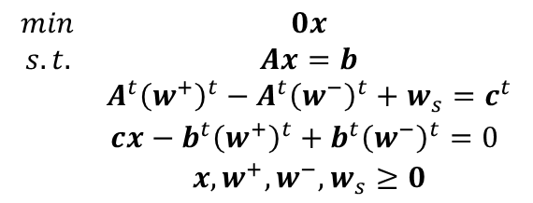
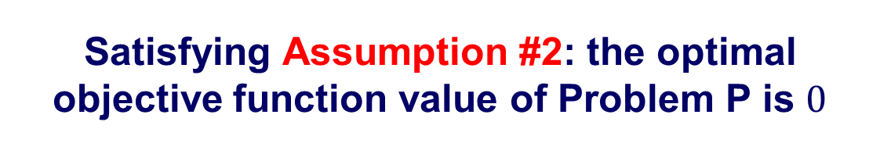
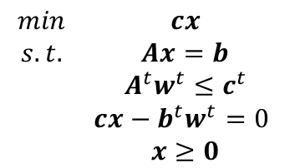


Satisfying Assumption #2: the optimal objective function value of Problem P is $0$
$$\begin{matrix}min & cx \\ s.t. & Ax=b \\ & x≥0\end{matrix}$$
The problem can be put into standard form
$$\begin{matrix}min & 0x \\ s.t. & Ax=b \\ & A^{t}{\left(w^{+}\right)}^{t}−A^{t}{\left(w^{−}\right)}^{t}+w_{s}=c^{t} \\ & cx−b^{t}{\left(w^{+}\right)}^{t}+b^{t}{\left(w^{−}\right)}^{t}=0 \\ & x,w^{+},w^{−},w_{s}≥0\end{matrix}$$
Recall the dual
$$\begin{matrix}max & wb \\ s.t. & wA≤c\end{matrix}$$
If a finite optimum exits, by strong duality
$$cx=wb$$
Which can be transformed into
$$\begin{matrix}min & 0x \\ s.t. & A^{′}x^{′}=b^{′} \\ & x′≥0\end{matrix}$$
The problem can be rewritten as follows
$$\begin{matrix}min & cx \\ s.t. & Ax=b \\ & A^{t}w^{t}≤c^{t} \\ & cx−b^{t}w^{t}=0 \\ & x≥0\end{matrix}$$

Slide 8
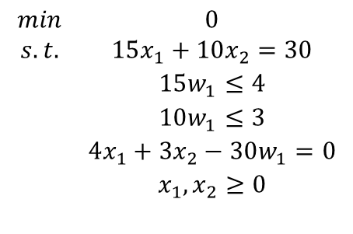
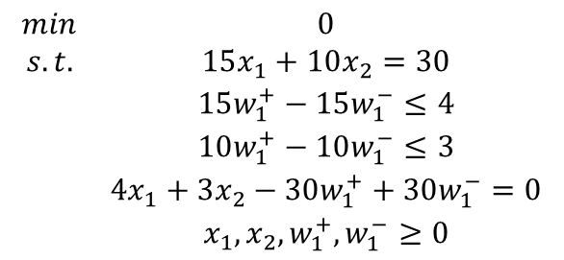
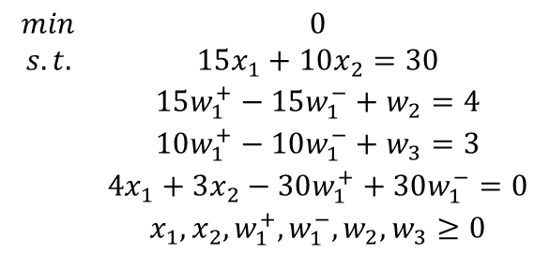
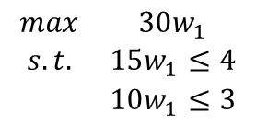
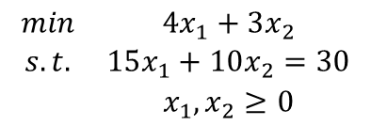
Satisfying Assumption #2: the optimal objective function value of Problem P is 0
The problem can then be rewritten as follows
$$\begin{matrix}min & 4x_{1}+3x_{2} \\ s.t. & 15x_{1}+10x_{2}=30 \\ & x_{1},x_{2}≥0\end{matrix}$$
$$\begin{matrix}min & 0 \\ s.t. & 15x_{1}+10x_{2}=30 \\ & 15w_{1}^{+}−15w_{1}^{−}≤4 \\ & 10w_{1}^{+}−10w_{1}^{−}≤3 \\ & 4x_{1}+3x_{2}−30w_{1}^{+}+30w_{1}^{−}=0 \\ & x_{1},x_{2},w_{1}^{+},w_{1}^{−}≥0\end{matrix}$$
Formulate the dual
$$\begin{matrix}max & 30w_{1} \\ s.t. & 15w_{1}≤4 \\ & 10w_{1}≤3\end{matrix}$$
And then put into standard form by adding slack variables, where needed…
Rewrite the problem as
$$\begin{matrix}min & 0 \\ s.t. & 15x_{1}+10x_{2}=30 \\ & 15w_{1}^{+}−15w_{1}^{−}+w_{2}=4 \\ & 10w_{1}^{+}−10w_{1}^{−}+w_{3}=3 \\ & 4x_{1}+3x_{2}−30w_{1}^{+}+30w_{1}^{−}=0 \\ & x_{1},x_{2},w_{1}^{+},w_{1}^{−},w_{2},w_{3}≥0\end{matrix}$$
$$\begin{matrix}min & 0 \\ s.t. & 15x_{1}+10x_{2}=30 \\ & 15w_{1}≤4 \\ & 10w_{1}≤3 \\ & 4x_{1}+3x_{2}−30w_{1}=0 \\ & x_{1},x_{2}≥0 \\ & \end{matrix}$$

Slide 9
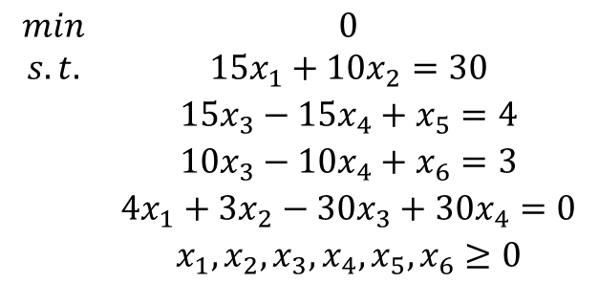
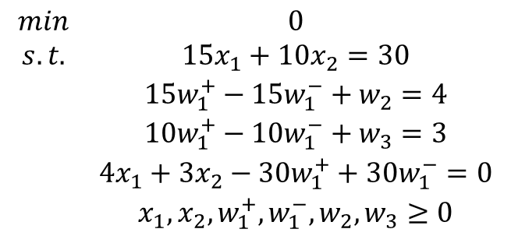
Let’s redefine some terms to make the next part easier to follow
$$\begin{matrix}min & 0 \\ s.t. & 15x_{1}+10x_{2}=30 \\ & 15w_{1}^{+}−15w_{1}^{−}+w_{2}=4 \\ & 10w_{1}^{+}−10w_{1}^{−}+w_{3}=3 \\ & 4x_{1}+3x_{2}−30w_{1}^{+}+30w_{1}^{−}=0 \\ & x_{1},x_{2},w_{1}^{+},w_{1}^{−},w_{2},w_{3}≥0\end{matrix}$$
$$\begin{matrix}min & 0 \\ s.t. & 15x_{1}+10x_{2}=30 \\ & 15x_{3}−15x_{4}+x_{5}=4 \\ & 10x_{3}−10x_{4}+x_{6}=3 \\ & 4x_{1}+3x_{2}−30x_{3}+30x_{4}=0 \\ & x_{1},x_{2},x_{3},x_{4},x_{5},x_{6}≥0\end{matrix}$$

Slide 10
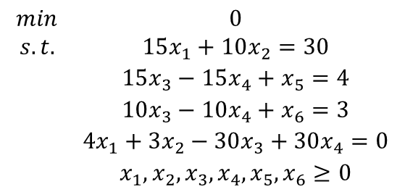
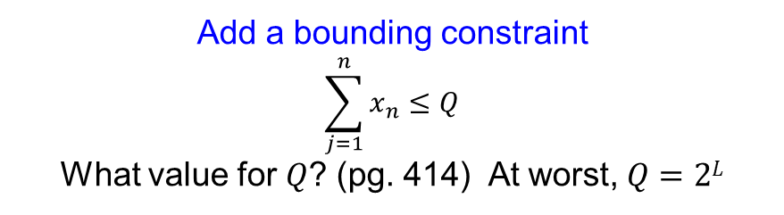
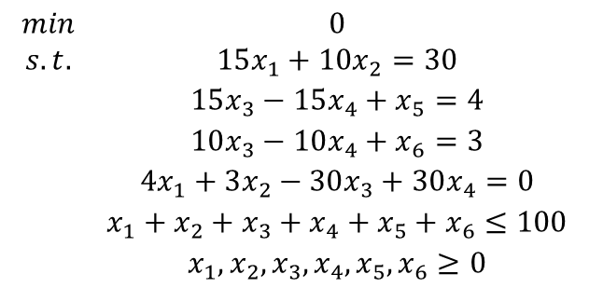
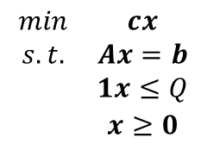
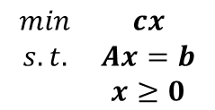
Transforming an LP in Standard Form for Karmarkar’s Projective Algorithm (1 of 4)
$$\begin{matrix}min & cx \\ s.t. & Ax=b \\ & x≥0\end{matrix}$$
$$\begin{matrix}min & 0 \\ s.t. & 15x_{1}+10x_{2}=30 \\ & 15x_{3}−15x_{4}+x_{5}=4 \\ & 10x_{3}−10x_{4}+x_{6}=3 \\ & 4x_{1}+3x_{2}−30x_{3}+30x_{4}=0 \\ & x_{1},x_{2},x_{3},x_{4},x_{5},x_{6}≥0\end{matrix}$$
Add a bounding constraint
$$\sum_{j=1}^{n}{x_{n}}≤Q$$
What value for $Q$? (pg. 414) At worst, $Q=2L$
$$\begin{matrix}min & cx \\ s.t. & Ax=b \\ & 1x≤Q \\ & x≥0\end{matrix}$$
$$\begin{matrix}min & 0 \\ s.t. & 15x_{1}+10x_{2}=30 \\ & 15x_{3}−15x_{4}+x_{5}=4 \\ & 10x_{3}−10x_{4}+x_{6}=3 \\ & 4x_{1}+3x_{2}−30x_{3}+30x_{4}=0 \\ & x_{1}+x_{2}+x_{3}+x_{4}+x_{5}+x_{6}≤100 \\ & x_{1},x_{2},x_{3},x_{4},x_{5},x_{6}≥0\end{matrix}$$

Slide 11
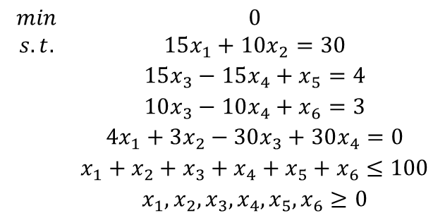
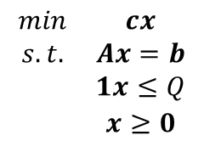
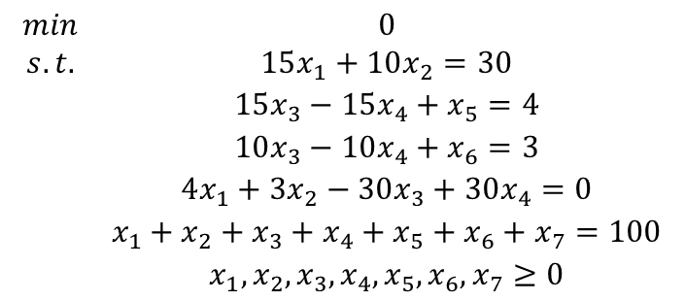
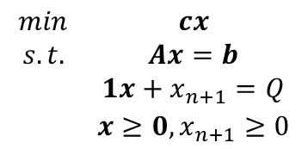
Transforming an LP in Standard Form for Karmarkar’s Projective Algorithm (2 of 4)
$$\begin{matrix}min & cx \\ s.t. & Ax=b \\ & 1x≤Q \\ & x≥0\end{matrix}$$
$$\begin{matrix}min & 0 \\ s.t. & 15x_{1}+10x_{2}=30 \\ & 15x_{3}−15x_{4}+x_{5}=4 \\ & 10x_{3}−10x_{4}+x_{6}=3 \\ & 4x_{1}+3x_{2}−30x_{3}+30x_{4}=0 \\ & x_{1}+x_{2}+x_{3}+x_{4}+x_{5}+x_{6}≤100 \\ & x_{1},x_{2},x_{3},x_{4},x_{5},x_{6}≥0\end{matrix}$$
Add a slack variable to convert to standard form
$$\begin{matrix}min & cx \\ s.t. & Ax=b \\ & 1x+x_{n+1}=Q \\ & x≥0,x_{n+1}≥0\end{matrix}$$
$$\begin{matrix}min & 0 \\ s.t. & 15x_{1}+10x_{2}=30 \\ & 15x_{3}−15x_{4}+x_{5}=4 \\ & 10x_{3}−10x_{4}+x_{6}=3 \\ & 4x_{1}+3x_{2}−30x_{3}+30x_{4}=0 \\ & x_{1}+x_{2}+x_{3}+x_{4}+x_{5}+x_{6}+x_{7}=100 \\ & x_{1},x_{2},x_{3},x_{4},x_{5},x_{6},x_{7}≥0\end{matrix}$$

Slide 12
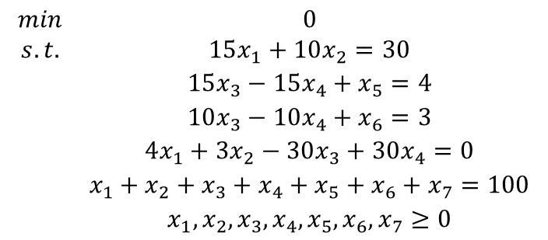
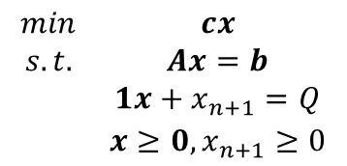
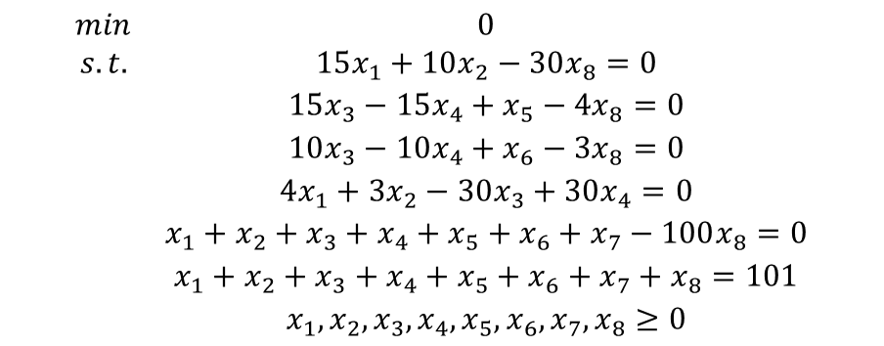
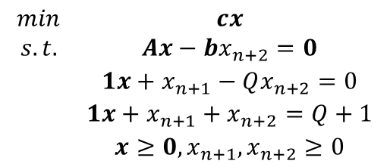
Transforming an LP in Standard Form for Karmarkar’s Projective Algorithm (3 of 4)
$$\begin{matrix}min & cx \\ s.t. & Ax=b \\ & 1x+x_{n+1}=Q \\ & x≥0,x_{n+1}≥0\end{matrix}$$
$$\begin{matrix}min & 0 \\ s.t. & 15x_{1}+10x_{2}=30 \\ & 15x_{3}−15x_{4}+x_{5}=4 \\ & 10x_{3}−10x_{4}+x_{6}=3 \\ & 4x_{1}+3x_{2}−30x_{3}+30x_{4}=0 \\ & x_{1}+x_{2}+x_{3}+x_{4}+x_{5}+x_{6}+x_{7}=100 \\ & x_{1},x_{2},x_{3},x_{4},x_{5},x_{6},x_{7}≥0\end{matrix}$$
Add a slack variable (having a value of 1) to modify the original constraint set
$$\begin{matrix}min & cx \\ s.t. & Ax−bx_{n+2}=0 \\ & 1x+x_{n+1}−Qx_{n+2}=0 \\ & 1x+x_{n+1}+x_{n+2}=Q+1 \\ & x≥0,x_{n+1},x_{n+2}≥0\end{matrix}$$
$$\begin{matrix}min & 0 \\ s.t. & 15x_{1}+10x_{2}−30x_{8}=0 \\ & 15x_{3}−15x_{4}+x_{5}−4x_{8}=0 \\ & 10x_{3}−10x_{4}+x_{6}−3x_{8}=0 \\ & 4x_{1}+3x_{2}−30x_{3}+30x_{4}=0 \\ & x_{1}+x_{2}+x_{3}+x_{4}+x_{5}+x_{6}+x_{7}−100x_{8}=0 \\ & x_{1}+x_{2}+x_{3}+x_{4}+x_{5}+x_{6}+x_{7}+x_{8}=101 \\ & x_{1},x_{2},x_{3},x_{4},x_{5},x_{6},x_{7},x_{8}≥0\end{matrix}$$

Slide 13

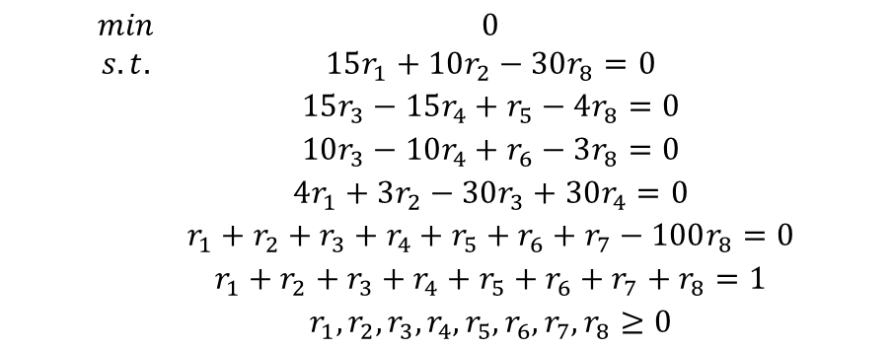
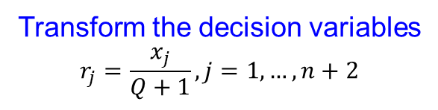
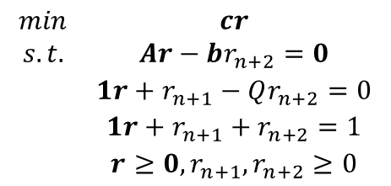
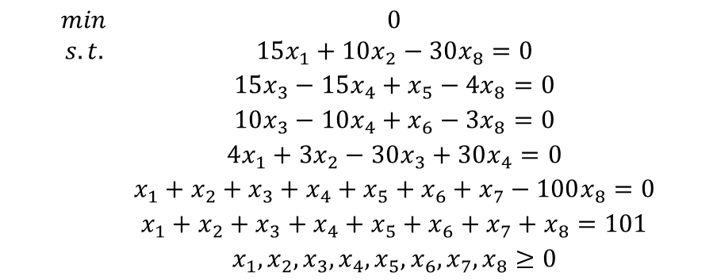
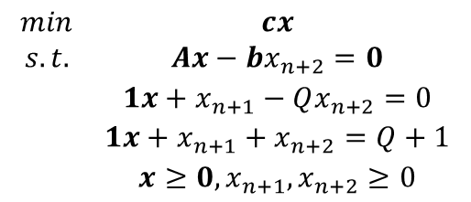
Transforming an LP in Standard Form for Karmarkar’s Projective Algorithm (4 of 4)
$$\begin{matrix}min & cx \\ s.t. & Ax−bx_{n+2}=0 \\ & 1x+x_{n+1}−Qx_{n+2}=0 \\ & 1x+x_{n+1}+x_{n+2}=Q+1 \\ & x≥0,x_{n+1},x_{n+2}≥0\end{matrix}$$
$$\begin{matrix}min & 0 \\ s.t. & 15x_{1}+10x_{2}−30x_{8}=0 \\ & 15x_{3}−15x_{4}+x_{5}−4x_{8}=0 \\ & 10x_{3}−10x_{4}+x_{6}−3x_{8}=0 \\ & 4x_{1}+3x_{2}−30x_{3}+30x_{4}=0 \\ & x_{1}+x_{2}+x_{3}+x_{4}+x_{5}+x_{6}+x_{7}−100x_{8}=0 \\ & x_{1}+x_{2}+x_{3}+x_{4}+x_{5}+x_{6}+x_{7}+x_{8}=101 \\ & x_{1},x_{2},x_{3},x_{4},x_{5},x_{6},x_{7},x_{8}≥0\end{matrix}$$
Transform the decision variables
$$r_{j}=\frac{x_{j}}{Q+1}, j=1,…,n+2$$
(Why did I use $rj$ in this example when the textbook uses $y_{j}$?)
$$\begin{matrix}min & cr \\ s.t. & Ar−br_{n+2}=0 \\ & 1r+r_{n+1}−Qr_{n+2}=0 \\ & 1r+r_{n+1}+r_{n+2}=1 \\ & r≥0,r_{n+1},r_{n+2}≥0\end{matrix}$$
$$\begin{matrix}min & 0 \\ s.t. & 15r_{1}+10r_{2}−30r_{8}=0 \\ & 15r_{3}−15r_{4}+r_{5}−4r_{8}=0 \\ & 10r_{3}−10r_{4}+r_{6}−3r_{8}=0 \\ & 4r_{1}+3r_{2}−30r_{3}+30r_{4}=0 \\ & r_{1}+r_{2}+r_{3}+r_{4}+r_{5}+r_{6}+r_{7}−100r_{8}=0 \\ & r_{1}+r_{2}+r_{3}+r_{4}+r_{5}+r_{6}+r_{7}+r_{8}=1 \\ & r_{1},r_{2},r_{3},r_{4},r_{5},r_{6},r_{7},r_{8}≥0\end{matrix}$$

Slide 14
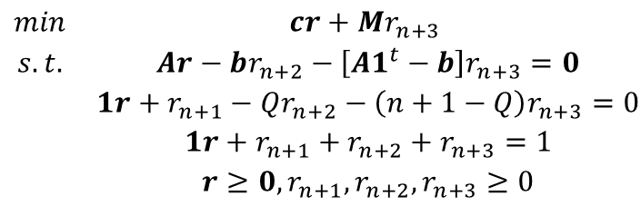
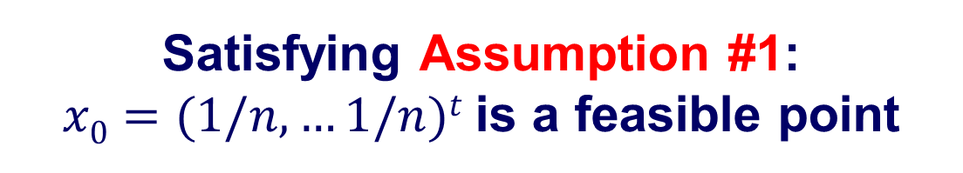
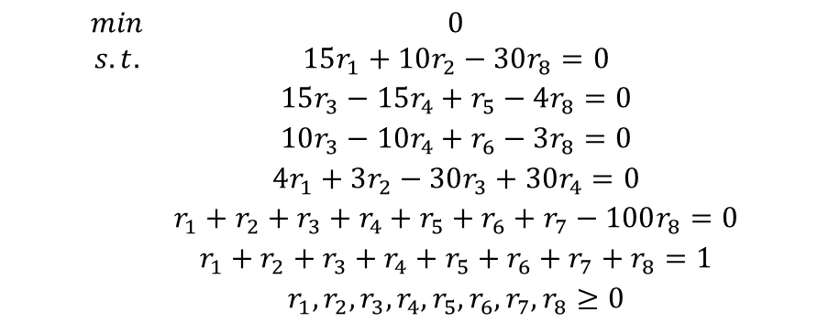
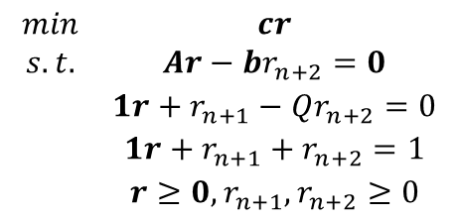


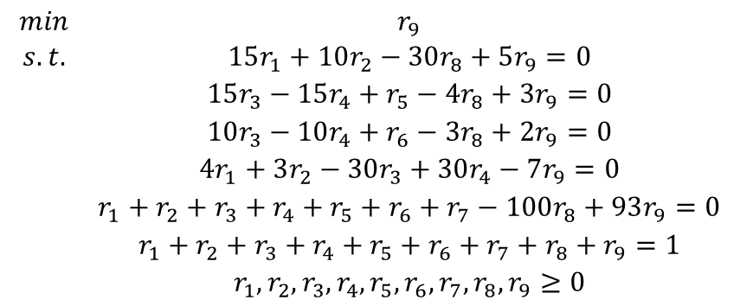
Satisfying Assumption #1: $x0=(1/n,…1/n)t$is a feasible point
$$\begin{matrix}min & cr \\ s.t. & Ar−br_{n+2}=0 \\ & 1r+r_{n+1}−Qr_{n+2}=0 \\ & 1r+r_{n+1}+r_{n+2}=1 \\ & r≥0,r_{n+1},r_{n+2}≥0\end{matrix}$$
$$\begin{matrix}min & 0 \\ s.t. & 15r_{1}+10r_{2}−30r_{8}=0 \\ & 15r_{3}−15r_{4}+r_{5}−4r_{8}=0 \\ & 10r_{3}−10r_{4}+r_{6}−3r_{8}=0 \\ & 4r_{1}+3r_{2}−30r_{3}+30r_{4}=0 \\ & r_{1}+r_{2}+r_{3}+r_{4}+r_{5}+r_{6}+r_{7}−100r_{8}=0 \\ & r_{1}+r_{2}+r_{3}+r_{4}+r_{5}+r_{6}+r_{7}+r_{8}=1 \\ & r_{1},r_{2},r_{3},r_{4},r_{5},r_{6},r_{7},r_{8}≥0\end{matrix}$$
Add an artificial variable such that the following point is feasible
$r_{0}={\left(\frac{1}{n+3},…,\frac{1}{n+3}\right)}^{t}$
$$\begin{matrix}min & cr+Mr_{n+3} \\ s.t. & Ar−br_{n+2}−\left[A1^{t}−b\right]r_{n+3}=0 \\ & 1r+r_{n+1}−Qr_{n+2}−\left(n+1−Q\right)r_{n+3}=0 \\ & 1r+r_{n+1}+r_{n+2}+r_{n+3}=1 \\ & r≥0,r_{n+1},r_{n+2},r_{n+3}≥0\end{matrix}$$
$$\begin{matrix}min & r_{9} \\ s.t. & 15r_{1}+10r_{2}−30r_{8}+5r_{9}=0 \\ & 15r_{3}−15r_{4}+r_{5}−4r_{8}+3r_{9}=0 \\ & 10r_{3}−10r_{4}+r_{6}−3r_{8}+2r_{9}=0 \\ & 4r_{1}+3r_{2}−30r_{3}+30r_{4}−7r_{9}=0 \\ & r_{1}+r_{2}+r_{3}+r_{4}+r_{5}+r_{6}+r_{7}−100r_{8}+93r_{9}=0 \\ & r_{1}+r_{2}+r_{3}+r_{4}+r_{5}+r_{6}+r_{7}+r_{8}+r_{9}=1 \\ & r_{1},r_{2},r_{3},r_{4},r_{5},r_{6},r_{7},r_{8},r_{9}≥0\end{matrix}$$
How did we get $M=1$?

Slide 15
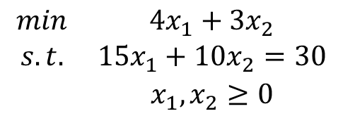
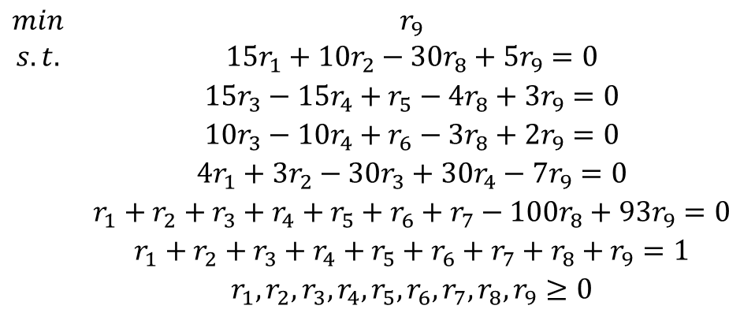
Do you see any patterns in the transformation?
$$\begin{matrix}min & 4x_{1}+3x_{2} \\ s.t. & 15x_{1}+10x_{2}=30 \\ & x_{1},x_{2}≥0\end{matrix}$$
$$\begin{matrix}min & r_{9} \\ s.t. & 15r_{1}+10r_{2}−30r_{8}+5r_{9}=0 \\ & 15r_{3}−15r_{4}+r_{5}−4r_{8}+3r_{9}=0 \\ & 10r_{3}−10r_{4}+r_{6}−3r_{8}+2r_{9}=0 \\ & 4r_{1}+3r_{2}−30r_{3}+30r_{4}−7r_{9}=0 \\ & r_{1}+r_{2}+r_{3}+r_{4}+r_{5}+r_{6}+r_{7}−100r_{8}+93r_{9}=0 \\ & r_{1}+r_{2}+r_{3}+r_{4}+r_{5}+r_{6}+r_{7}+r_{8}+r_{9}=1 \\ & r_{1},r_{2},r_{3},r_{4},r_{5},r_{6},r_{7},r_{8},r_{9}≥0\end{matrix}$$
Change the $r_{j}$’s to $x_{j}$’s (for notational consistency), and now you can start Karmarkar’s algorithm.

Slide 16
Karmarkar’s Projective Algorithm
Advantages?
Disadvantages?
Quirks?
Why are Assumption #2 and Assumption #1 (and the standard form) necessary for this algorithm to work?

Slide 17
Questions & Discussion

Slide 18
For Next Class
Section 8.6
Homework #13: Problem 8.1
Show convergence (in the original x-space) via a plot for full credit
Experiment with algorithmic settings (i.e., one factor at-a-time sensitivity analysis) for 11/10 points

